Slide 1
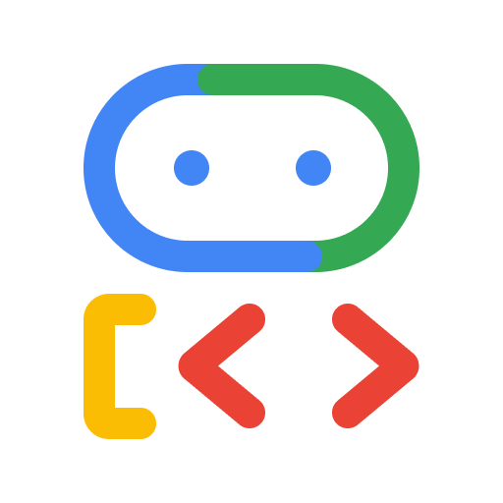
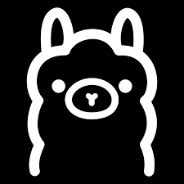


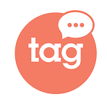
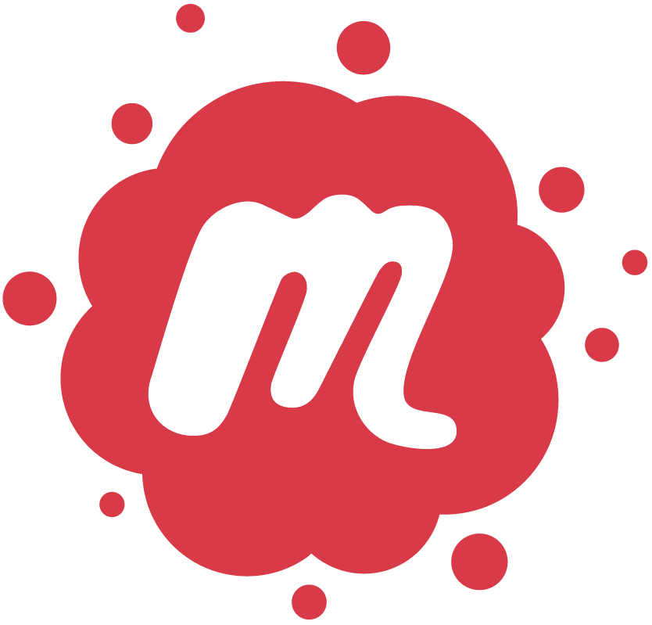
Smart AI
Building
Milan, 28th November
Building Agents with ADK and Ollama
Notes:
This slide is not just a question—it’s an invitation to reimagine what your enterprise could truly be.
For too long, we've focused on incremental gains, trying to make our employees slightly faster at their repetitive tasks. That model is outdated. The old way was constrained by siloed, app-dependent work. The new way is about limitless potential.
What if every one of your employees could harness everything that AI has to offer, working not just faster, but smarter and more creatively?
Imagine your workforce is suddenly multidimensional: They are freed from the friction of repetitive work, capable of doing more with less, and are empowered to focus their time and energy on strategic, high-value activities. They are not just completing tasks; they are becoming strategic innovators.
This shift ignites true team productivity. It unlocks the collective intelligence of your organization. It is the path to achieving More creativity, more impact, and more possibilities across your entire business.

Slide 2
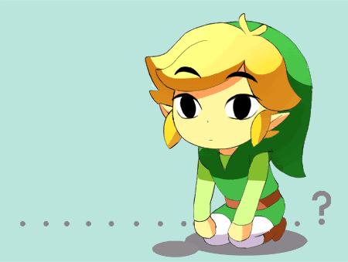
<> Google Developer Groups
Who Am I
Zelda Ailine Luconi
8+ years in the field of Cloud, Data and AI
Started as researcher at University of Florence
Worked for 3 years as AI Engineer at Samsung
Moved to Consultancy at xTech BIP
Currently working at Datwave
Currently collaborating with the CNR (Italian Center of National Research) on medicanes prediction
Love to travel and learning languages not only natural but also programming ones
Notes:
This slide is not just a question—it’s an invitation to reimagine what your enterprise could truly be.
For too long, we've focused on incremental gains, trying to make our employees slightly faster at their repetitive tasks. That model is outdated. The old way was constrained by siloed, app-dependent work. The new way is about limitless potential.
What if every one of your employees could harness everything that AI has to offer, working not just faster, but smarter and more creatively?
Imagine your workforce is suddenly multidimensional: They are freed from the friction of repetitive work, capable of doing more with less, and are empowered to focus their time and energy on strategic, high-value activities. They are not just completing tasks; they are becoming strategic innovators.
This shift ignites true team productivity. It unlocks the collective intelligence of your organization. It is the path to achieving More creativity, more impact, and more possibilities across your entire business.

Slide 3

What do LLM, Agents and Agentic AI bring to the table?
More creativity.
More impact.
More possibilities.
Notes:
This slide is not just a question—it’s an invitation to reimagine what your enterprise could truly be.
For too long, we've focused on incremental gains, trying to make our employees slightly faster at their repetitive tasks. That model is outdated. The old way was constrained by siloed, app-dependent work. The new way is about limitless potential.
What if every one of your employees could harness everything that AI has to offer, working not just faster, but smarter and more creatively?
Imagine your workforce is suddenly multidimensional: They are freed from the friction of repetitive work, capable of doing more with less, and are empowered to focus their time and energy on strategic, high-value activities. They are not just completing tasks; they are becoming strategic innovators.
This shift ignites true team productivity. It unlocks the collective intelligence of your organization. It is the path to achieving More creativity, more impact, and more possibilities across your entire business.

Slide 4


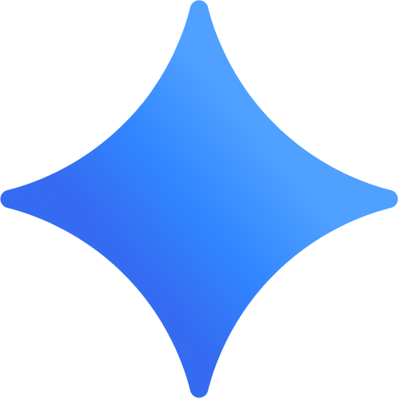

<> Google Developer Groups
What is the difference between
LLM, Agents and Agentic AI?
The Brains
a passive knowledge engine that processes and generates human-like text based on statistical patterns, but it cannot inherently take action or interact with the outside world beyond the conversation.
The Workbench
specific software entity that uses an LLM as its "brain" to reason and then actively uses external tools (like web search, code executors, or APIs) to complete concrete tasks.
The Taskforce
the broader design paradigm or capability level of systems that exhibit high autonomy, enabling them to formulate their own plans, self-correct, and pursue complex goals with minimal human intervention.
The LLM
The Agent
The Agentic AI
Notes:
Our advanced agentic platform, Gemini Enterprise, provides a single platform to discover, create, share, and run AI agents across the organization. Built with Gemini, it is designed to be the central nervous system for AI in your business — continuously delivering Google's most advanced AI to every individual.
It unifies five core components on a single, secure foundation:
The Brains: World-class Gemini models as the core intelligence, including models people know and love like Nano Banana
The Workbench: A powerful no-code platform to build and orchestrate agents
The Taskforce: A suite of specialized, pre-built agents from Google
The Context: Secure grounding in your company's complete data landscape
The Governance: A single dashboard for enterprise-grade security and controls
This is a true system of intelligence that moves beyond simple task acceleration to automate entire workflows, empowering every employee to transform work.
Optional talking points: So, what does that mean for your teams every day? We like to think of Gemini Enterprise as the new front door to AI in the workplace.
[Go from tedious tasks to high-impact work] This starts with an intuitive chat interface, giving every employee direct access to our most advanced Gemini models. From there, they can call upon a ready-to-use AI taskforce — with specialized agents from Google and our partners for deep research, data insights, and coding — to automate complex workflows and free your teams to focus on their most important work.
[Turn team expertise into custom-built AI for everyone] Second, Gemini Enterprise is a platform for every employee, not just developers. Any user, from marketing to finance, can use powerful no-code tools to create their own AI agents. They can connect these agents to their specific business data and favorite productivity apps, and then publish them for the entire organization to use — turning their unique expertise into a scalable asset for the business.
[Govern agents securely and scale them with confidence] Finally, Gemini Enterprise is built for enterprise-grade control and compliance. Gemini Enterprise gives you a central place to visualize, secure, audit, and govern every AI agent being used — whether they were built with Gemini or even with other models. This gives your IT and security teams the full visibility and control they need.

Slide 5
<> Google Developer Groups
… but in reality is more an
Evolution of the term “Agent”
LLM
LLM
LLM
RAG
LLM
RAG
Tools
RAG
Tools
LLM + prompt
LLM + retrieval
LLM + retrieval
+ actions
+ Many tools and reasoning loop
Multi agent systems
Remote multi agent systems
Notes:
Option 1 (Shorter talking points if you’re double clicking into each pillar and presenting slides 13, 14, 15)
So, what does that mean for your teams every day? We like to think of Gemini Enterprise as the new front door to AI in the workplace.
First, we help every individual go from tedious tasks to high-impact work. This is all about empowering your people with a ready-to-use AI taskforce so they can focus on what matters most.
Second, we enable anyone to build and share their own agents, all securely grounded in your organization's data. This is about democratizing innovation, allowing any employee to scale their unique knowledge across the entire business.
And finally, we ensure you can govern agents securely and scale with confidence. This provides the foundation of trust and control that makes enterprise-wide AI adoption possible.
These are our three core promises. Let’s take a closer look at how we deliver on each one, and how this comes to life for employees.
Option 2 (Expanded talking points if you’re only using this slide)
So, what does that mean for your teams every day? We like to think of Gemini Enterprise as the new front door to AI in the workplace.
[Go from tedious tasks to high-impact work] This starts with an intuitive chat interface, giving every employee direct access to our most advanced Gemini models. From there, they can call upon a ready-to-use AI taskforce — with specialized agents from Google and our partners for deep research, data insights, and coding — to automate complex workflows and free your teams to focus on their most important work.
[Turn team expertise into custom-built AI for everyone] Second, Gemini Enterprise is a platform for every employee, not just developers. Any user, from marketing to finance, can use powerful no-code tools to create their own AI agents. They can connect these agents to their specific business data and favorite productivity apps, and then publish them for the entire organization to use — turning their unique expertise into a scalable asset for the business.
[Govern agents securely and scale them with confidence] Finally, Gemini Enterprise is built for enterprise-grade control and compliance. Gemini Enterprise gives you a central place to visualize, secure, audit, and govern every AI agent being used — whether they were built with Gemini or even with other models. This gives your IT and security teams the full visibility and control they need.

Slide 6
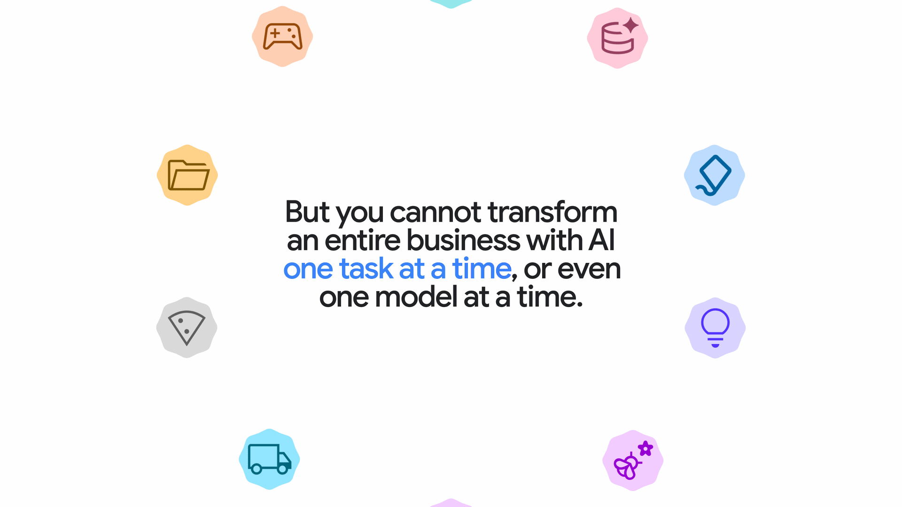
Don’t let hype about AI agents get ahead of reality
There is enormous potential for this technology, but only if we deploy it responsibly.
— MIT Technology Review

Slide 7
<> Google Developer Groups
What is Google ADK (Agent Developer Kit)?
🚗💨
building a car engine from scratch
VS
buying a pre-assembled engine block that fits into a standard chassis.
🏎️. ݁₊ ⊹ . ݁˖ .
Notes:
This slide is not just a question—it’s an invitation to reimagine what your enterprise could truly be.
For too long, we've focused on incremental gains, trying to make our employees slightly faster at their repetitive tasks. That model is outdated. The old way was constrained by siloed, app-dependent work. The new way is about limitless potential.
What if every one of your employees could harness everything that AI has to offer, working not just faster, but smarter and more creatively?
Imagine your workforce is suddenly multidimensional: They are freed from the friction of repetitive work, capable of doing more with less, and are empowered to focus their time and energy on strategic, high-value activities. They are not just completing tasks; they are becoming strategic innovators.
This shift ignites true team productivity. It unlocks the collective intelligence of your organization. It is the path to achieving More creativity, more impact, and more possibilities across your entire business.

Slide 8
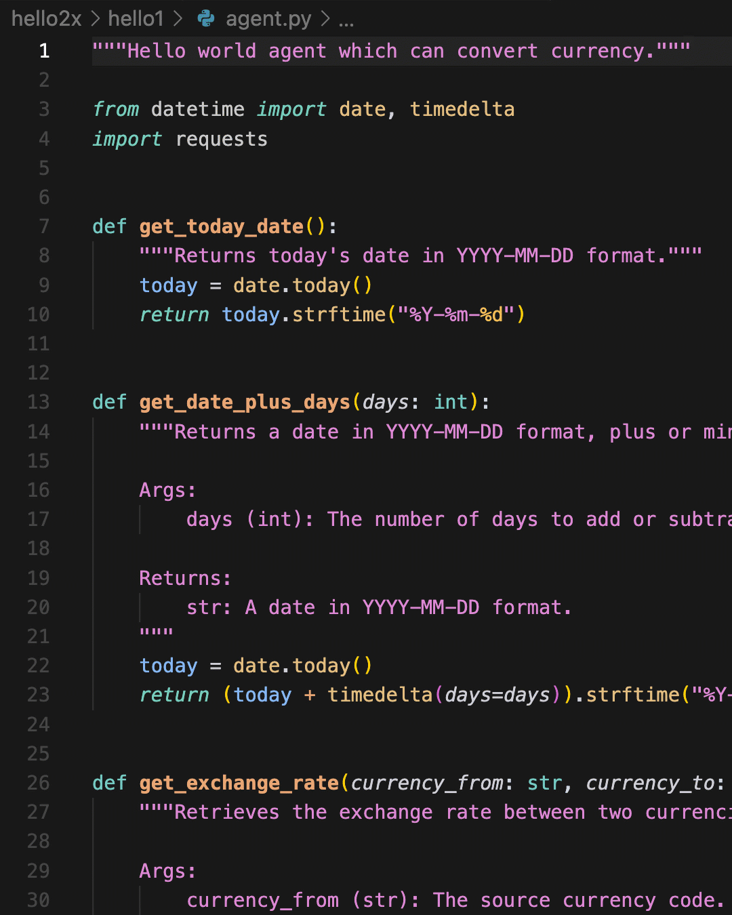
WHAT IS
<> Google Developer Groups
ADK
01
Open-Source Framework
An open-source (Apache 2.0) framework for building AI agents.
02
Multi-Language Support
Supports Python (which we'll use), Go, and Java.
03
Code-First & No-Code GUI
Toolkit for developers to build production-grade agents using code ("Code-First" Philosophy) but recently also features a no-code GUI.
Notes:
This slide is not just a question—it’s an invitation to reimagine what your enterprise could truly be.
For too long, we've focused on incremental gains, trying to make our employees slightly faster at their repetitive tasks. That model is outdated. The old way was constrained by siloed, app-dependent work. The new way is about limitless potential.
What if every one of your employees could harness everything that AI has to offer, working not just faster, but smarter and more creatively?
Imagine your workforce is suddenly multidimensional: They are freed from the friction of repetitive work, capable of doing more with less, and are empowered to focus their time and energy on strategic, high-value activities. They are not just completing tasks; they are becoming strategic innovators.
This shift ignites true team productivity. It unlocks the collective intelligence of your organization. It is the path to achieving More creativity, more impact, and more possibilities across your entire business.

Slide 9
WHY SHOULD YOU USE
<> Google Developer Groups
ADK
01
The "Polymorphism" Benefit
Forces interchangeable parts to adhere to a unified interface.
02
Mix Control on Tools & Agents
Combine prebuilt and custom tools to range from deterministic to non-deterministic workflows.
03
Orchestration & Routing Logic
Compose small, specialized agents into complex, hierarchical multi-agent systems.
04
Built-in State Management
Raw LLM APIs are stateless; ADK adds an "Invisible Backpack" for seamless state persistence.
Notes:
This slide is not just a question—it’s an invitation to reimagine what your enterprise could truly be.
For too long, we've focused on incremental gains, trying to make our employees slightly faster at their repetitive tasks. That model is outdated. The old way was constrained by siloed, app-dependent work. The new way is about limitless potential.
What if every one of your employees could harness everything that AI has to offer, working not just faster, but smarter and more creatively?
Imagine your workforce is suddenly multidimensional: They are freed from the friction of repetitive work, capable of doing more with less, and are empowered to focus their time and energy on strategic, high-value activities. They are not just completing tasks; they are becoming strategic innovators.
This shift ignites true team productivity. It unlocks the collective intelligence of your organization. It is the path to achieving More creativity, more impact, and more possibilities across your entire business.

Slide 10
LET'S START WITH
Demo 1
• How to use adk create <agent-name>
•Structure of a simple agent (agent.py, .env, __init__)
•How to declare an LLM Agent() Class
⚡ REMEMBER
For agents folder names, always use _ (underscore)
Always have a root_agent in your agent.py
Notes:
This slide is not just a question—it’s an invitation to reimagine what your enterprise could truly be.
For too long, we've focused on incremental gains, trying to make our employees slightly faster at their repetitive tasks. That model is outdated. The old way was constrained by siloed, app-dependent work. The new way is about limitless potential.
What if every one of your employees could harness everything that AI has to offer, working not just faster, but smarter and more creatively?
Imagine your workforce is suddenly multidimensional: They are freed from the friction of repetitive work, capable of doing more with less, and are empowered to focus their time and energy on strategic, high-value activities. They are not just completing tasks; they are becoming strategic innovators.
This shift ignites true team productivity. It unlocks the collective intelligence of your organization. It is the path to achieving More creativity, more impact, and more possibilities across your entire business.

Slide 11

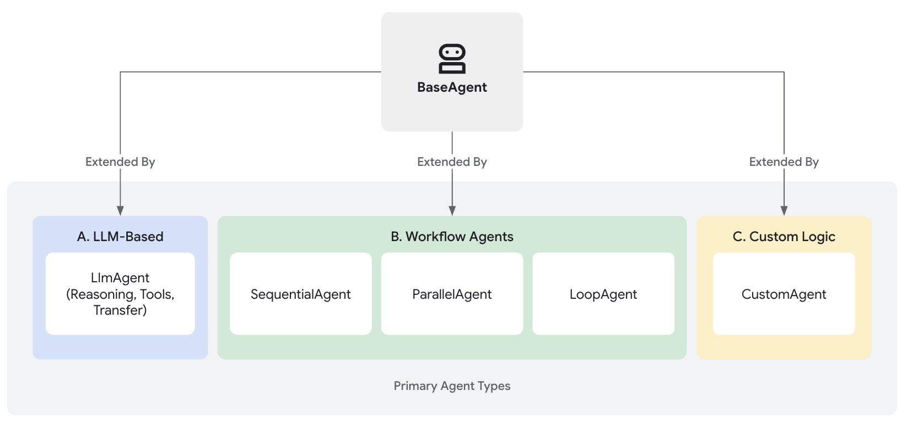
Let’s start with
ADK Agent Types
🤖
LLM Agent
This is the agent that uses an LLM for reasoning. Its job is to process unstructured input (a user's chat), understand the intent, and decide what to do. It uses a method like ReAct to choose whether to answer, call a tool, or delegate.
Notes:
This slide is not just a question—it’s an invitation to reimagine what your enterprise could truly be.
For too long, we've focused on incremental gains, trying to make our employees slightly faster at their repetitive tasks. That model is outdated. The old way was constrained by siloed, app-dependent work. The new way is about limitless potential.
What if every one of your employees could harness everything that AI has to offer, working not just faster, but smarter and more creatively?
Imagine your workforce is suddenly multidimensional: They are freed from the friction of repetitive work, capable of doing more with less, and are empowered to focus their time and energy on strategic, high-value activities. They are not just completing tasks; they are becoming strategic innovators.
This shift ignites true team productivity. It unlocks the collective intelligence of your organization. It is the path to achieving More creativity, more impact, and more possibilities across your entire business.

Slide 12
NEXT...
<> Google Developer Groups
Demo 2
tool_state.py
How to swap models & limitations:
Gemini vs. Ollama
LiteLLM(): Universal translator for LLM APIs (ADK ↔ Ollama)
How to structure a tool folder
# Returning Tool State Examples
# 1. Success State
return {
"status": "success",
"answer": xxxx
}
# 2. Error State
return {
"status": "error",
"error_message": xxx
}
💡 LITELLM INTEGRATION
Acts as a universal proxy so ADK (Python library) can seamlessly communicate with an Ollama server or alternative LLM backends without code rewrites.
Notes:
This slide is not just a question—it’s an invitation to reimagine what your enterprise could truly be.
For too long, we've focused on incremental gains, trying to make our employees slightly faster at their repetitive tasks. That model is outdated. The old way was constrained by siloed, app-dependent work. The new way is about limitless potential.
What if every one of your employees could harness everything that AI has to offer, working not just faster, but smarter and more creatively?
Imagine your workforce is suddenly multidimensional: They are freed from the friction of repetitive work, capable of doing more with less, and are empowered to focus their time and energy on strategic, high-value activities. They are not just completing tasks; they are becoming strategic innovators.
This shift ignites true team productivity. It unlocks the collective intelligence of your organization. It is the path to achieving More creativity, more impact, and more possibilities across your entire business.

Slide 13
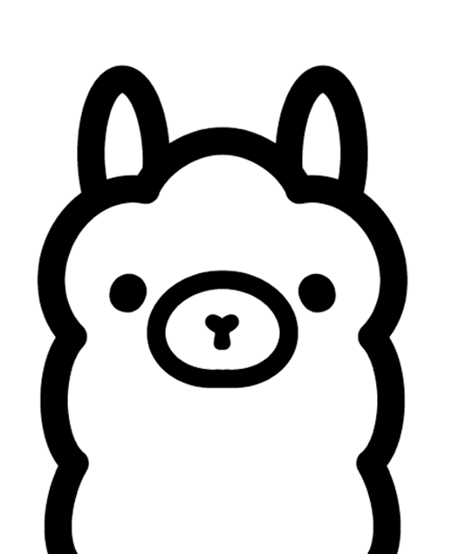
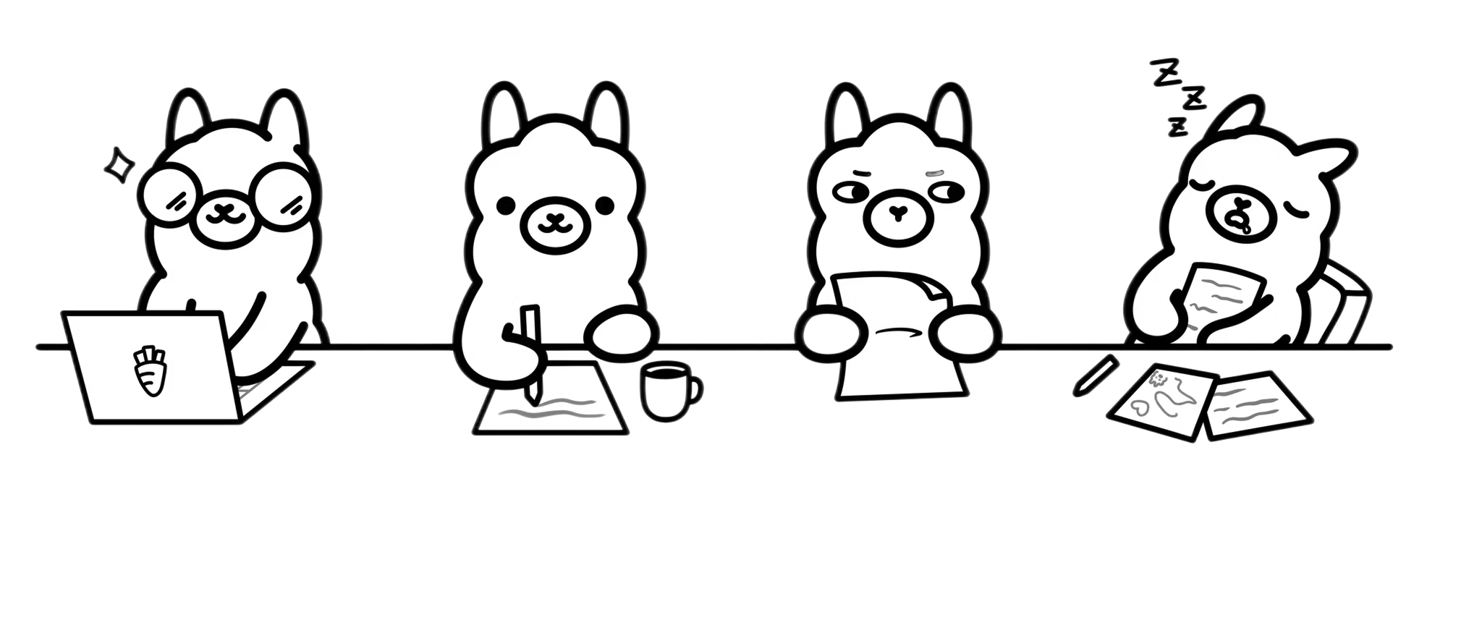
<> Google Developer Groups
What is
Ollama
simplifies running large language models locally
Easily set up and manage open-source LLMs like Llama 3.1
Provides a simple command-line interface for interaction
Supports GPU acceleration for faster local performance
Bundles the model weights, configuration, and a server into a single, easy-to-use package. It's like "Docker for LLMs."

Slide 14
<> Google Developer Groups
When to use it
Ollama
Offline & On-Premise: Build robust applications that run on a laptop, on-prem server, or even an edge device with no internet connection.
Control & Customization: Stop relying on a black-box API. You can use specific fine-tuned models, custom models (e.g., GGUF), and control the exact version.
Privacy & Data Sovereignty: Your prompts, sensitive documents, and proprietary code never leave your machine. This is non-negotiable for legal, medical, or R&D data.
Zero Cost (for Inference): Move from a pay-per-token API model to a fixed hardware cost. Allows for massive-scale experimentation and production use without runaway API bills.

Slide 15
TO CLEAR SOME CONCEPTS
<> Google Developer Groups
Demo 2
buildCONCEPT 01
Built-in vs Custom Tools
Understanding core tool mechanics, out-of-the-box capabilities, and how to build tailored custom toolsets.
hubCONCEPT 02
Subagents vs Tools
Key structural and operational differences between subagent delegation and direct tool execution.
PLUS
How to use configuration files rather than keeping a unique agent.py
Notes:
This slide is not just a question—it’s an invitation to reimagine what your enterprise could truly be.
For too long, we've focused on incremental gains, trying to make our employees slightly faster at their repetitive tasks. That model is outdated. The old way was constrained by siloed, app-dependent work. The new way is about limitless potential.
What if every one of your employees could harness everything that AI has to offer, working not just faster, but smarter and more creatively?
Imagine your workforce is suddenly multidimensional: They are freed from the friction of repetitive work, capable of doing more with less, and are empowered to focus their time and energy on strategic, high-value activities. They are not just completing tasks; they are becoming strategic innovators.
This shift ignites true team productivity. It unlocks the collective intelligence of your organization. It is the path to achieving More creativity, more impact, and more possibilities across your entire business.

Slide 16

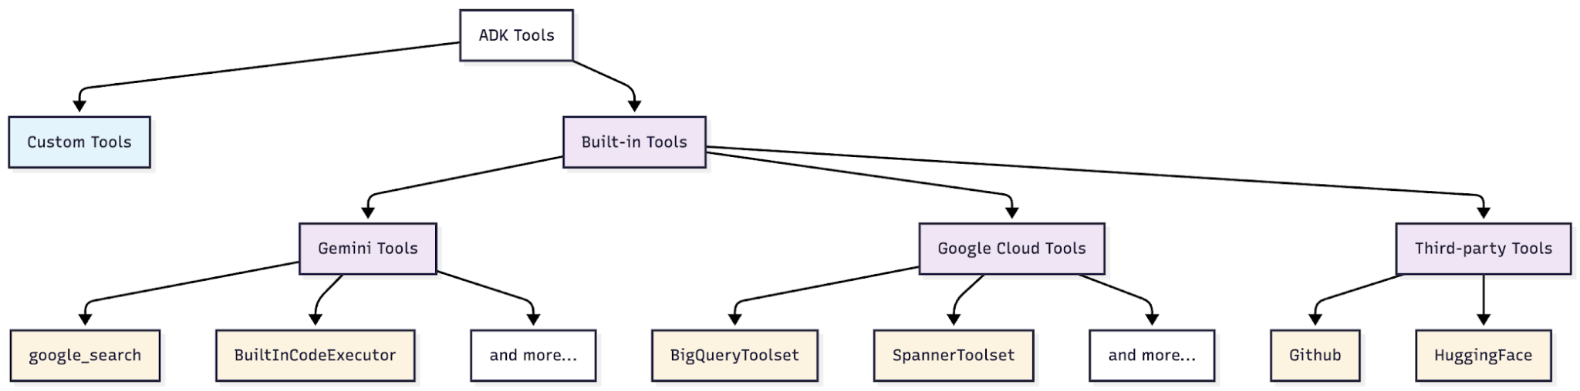
<> Google Developer Groups
What are
Built-in Tools
Advantage:
Reliable, tested tools that work out of the box
Advantage: Enterprise-grade database and API access with built-in security
Advantage: Enterprise-grade database and API access with built-in security
Notes:
This slide is not just a question—it’s an invitation to reimagine what your enterprise could truly be.
For too long, we've focused on incremental gains, trying to make our employees slightly faster at their repetitive tasks. That model is outdated. The old way was constrained by siloed, app-dependent work. The new way is about limitless potential.
What if every one of your employees could harness everything that AI has to offer, working not just faster, but smarter and more creatively?
Imagine your workforce is suddenly multidimensional: They are freed from the friction of repetitive work, capable of doing more with less, and are empowered to focus their time and energy on strategic, high-value activities. They are not just completing tasks; they are becoming strategic innovators.
This shift ignites true team productivity. It unlocks the collective intelligence of your organization. It is the path to achieving More creativity, more impact, and more possibilities across your entire business.

Slide 17
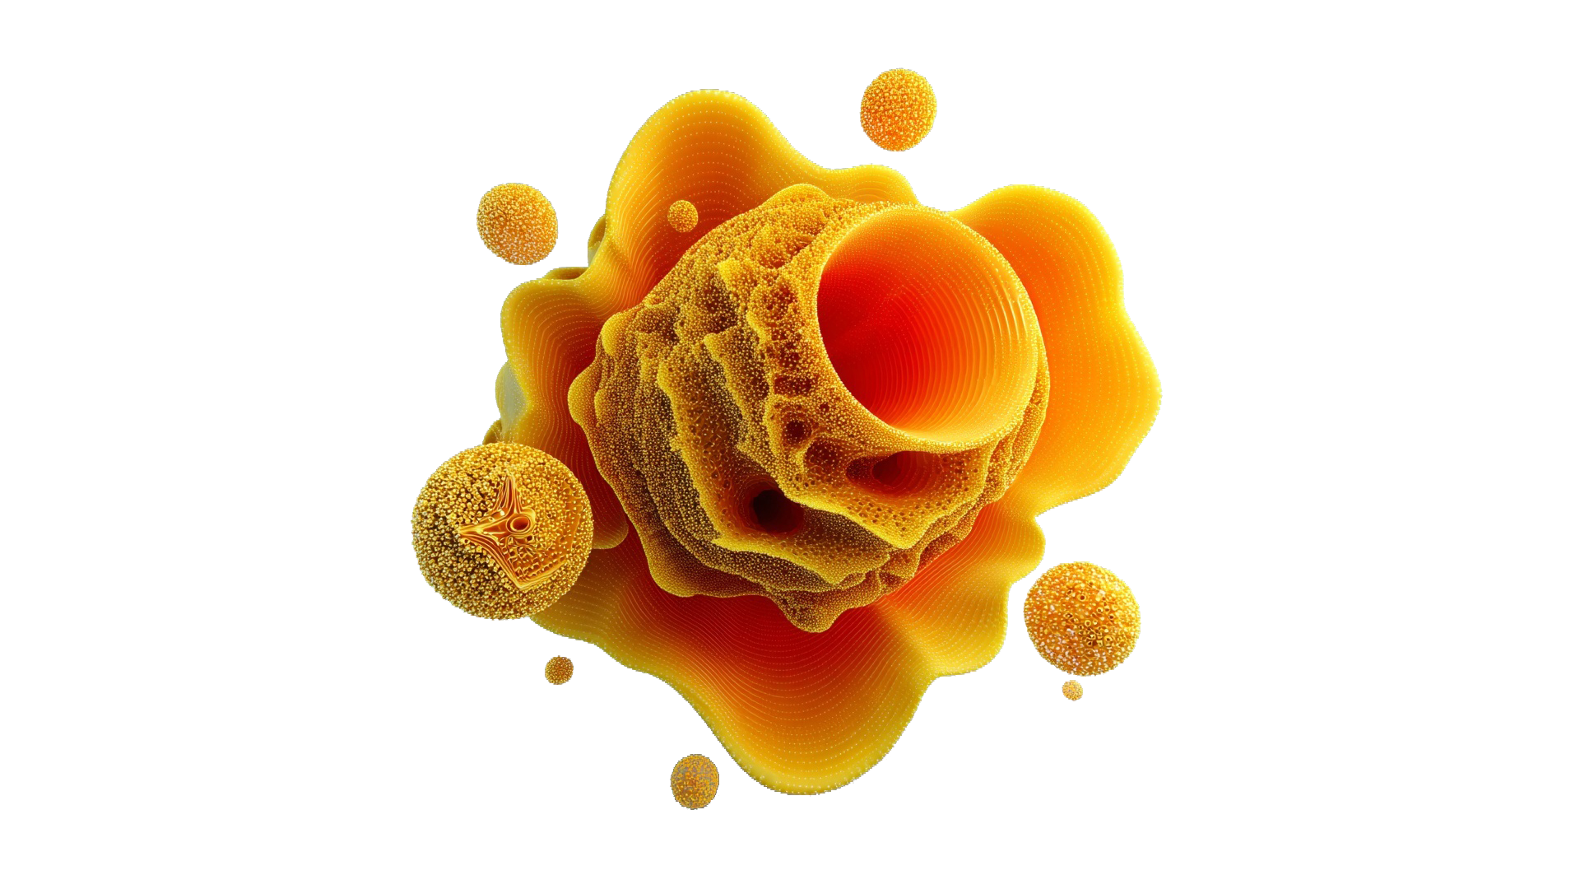
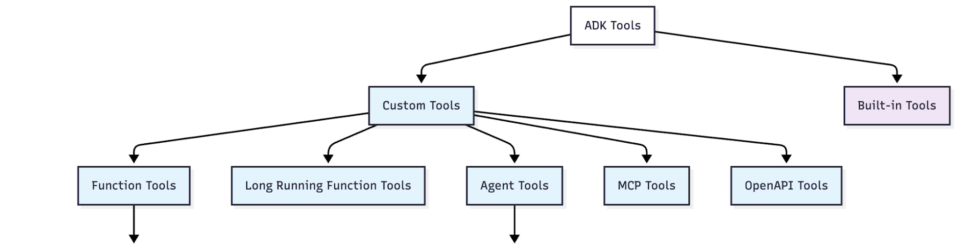
Let’s start with
Custom Tools
Advantage: Turn any Python function into an agent tool instantly
Advantage: Build specialist agents and reuse them across different systems
Notes:
This slide is not just a question—it’s an invitation to reimagine what your enterprise could truly be.
For too long, we've focused on incremental gains, trying to make our employees slightly faster at their repetitive tasks. That model is outdated. The old way was constrained by siloed, app-dependent work. The new way is about limitless potential.
What if every one of your employees could harness everything that AI has to offer, working not just faster, but smarter and more creatively?
Imagine your workforce is suddenly multidimensional: They are freed from the friction of repetitive work, capable of doing more with less, and are empowered to focus their time and energy on strategic, high-value activities. They are not just completing tasks; they are becoming strategic innovators.
This shift ignites true team productivity. It unlocks the collective intelligence of your organization. It is the path to achieving More creativity, more impact, and more possibilities across your entire business.

Slide 18
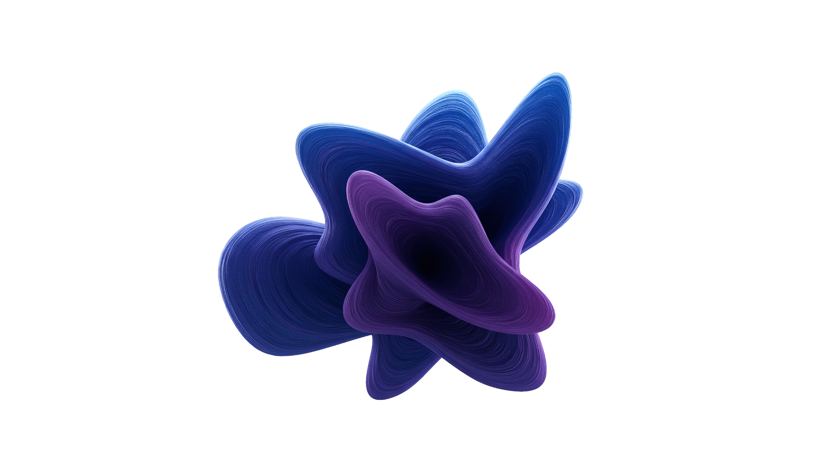
What is the difference between
Agent Tools and SubAgents
🛠️🤖
⬇️🤖
Agent Tools
SubAgents
Agent A calls Agent B as a tool
Agent B's response goes back to Agent A
Agent A stays in control and continues the conversation
Use case: Delegation for specific tasks (like calculations)
Agent A transfers control completely to Agent B
Agent B takes over and handles all future user input
Agent A is out of the loop
Use case: Handoff to specialists (like customer support tiers)
Notes:
Option 1 (Shorter talking points if you’re double clicking into each pillar and presenting slides 13, 14, 15)
So, what does that mean for your teams every day? We like to think of Gemini Enterprise as the new front door to AI in the workplace.
First, we help every individual go from tedious tasks to high-impact work. This is all about empowering your people with a ready-to-use AI taskforce so they can focus on what matters most.
Second, we enable anyone to build and share their own agents, all securely grounded in your organization's data. This is about democratizing innovation, allowing any employee to scale their unique knowledge across the entire business.
And finally, we ensure you can govern agents securely and scale with confidence. This provides the foundation of trust and control that makes enterprise-wide AI adoption possible.
These are our three core promises. Let’s take a closer look at how we deliver on each one, and how this comes to life for employees.
Option 2 (Expanded talking points if you’re only using this slide)
So, what does that mean for your teams every day? We like to think of Gemini Enterprise as the new front door to AI in the workplace.
[Go from tedious tasks to high-impact work] This starts with an intuitive chat interface, giving every employee direct access to our most advanced Gemini models. From there, they can call upon a ready-to-use AI taskforce — with specialized agents from Google and our partners for deep research, data insights, and coding — to automate complex workflows and free your teams to focus on their most important work.
[Turn team expertise into custom-built AI for everyone] Second, Gemini Enterprise is a platform for every employee, not just developers. Any user, from marketing to finance, can use powerful no-code tools to create their own AI agents. They can connect these agents to their specific business data and favorite productivity apps, and then publish them for the entire organization to use — turning their unique expertise into a scalable asset for the business.
[Govern agents securely and scale them with confidence] Finally, Gemini Enterprise is built for enterprise-grade control and compliance. Gemini Enterprise gives you a central place to visualize, secure, audit, and govern every AI agent being used — whether they were built with Gemini or even with other models. This gives your IT and security teams the full visibility and control they need.

Slide 19
NEXT
<> Google Developer Groups
Demo 3
• What is a Workflow Agent
• How to share states using output_key = <state-variable-name>
⚡ EXAMPLE
Agent with SequentialAgent() that manages a linear pipeline containing a LoopAgent()
Notes:
This slide is not just a question—it’s an invitation to reimagine what your enterprise could truly be.
For too long, we've focused on incremental gains, trying to make our employees slightly faster at their repetitive tasks. That model is outdated. The old way was constrained by siloed, app-dependent work. The new way is about limitless potential.
What if every one of your employees could harness everything that AI has to offer, working not just faster, but smarter and more creatively?
Imagine your workforce is suddenly multidimensional: They are freed from the friction of repetitive work, capable of doing more with less, and are empowered to focus their time and energy on strategic, high-value activities. They are not just completing tasks; they are becoming strategic innovators.
This shift ignites true team productivity. It unlocks the collective intelligence of your organization. It is the path to achieving More creativity, more impact, and more possibilities across your entire business.

Slide 20
Let’s start with
ADK Agent Types
🤖
🤖
Workflow Agents
LLM Agent
These agents are 100% deterministic. They do *not* use an LLM to decide the flow. They are pure code. Examples: SequentialAgent (A -> B -> C), ParallelAgent, LoopAgent.
This is the agent that uses an LLM for reasoning. Its job is to process unstructured input (a user's chat), understand the intent, and decide what to do. It uses a method like ReAct to choose whether to answer, call a tool, or delegate.
Notes:
This slide is not just a question—it’s an invitation to reimagine what your enterprise could truly be.
For too long, we've focused on incremental gains, trying to make our employees slightly faster at their repetitive tasks. That model is outdated. The old way was constrained by siloed, app-dependent work. The new way is about limitless potential.
What if every one of your employees could harness everything that AI has to offer, working not just faster, but smarter and more creatively?
Imagine your workforce is suddenly multidimensional: They are freed from the friction of repetitive work, capable of doing more with less, and are empowered to focus their time and energy on strategic, high-value activities. They are not just completing tasks; they are becoming strategic innovators.
This shift ignites true team productivity. It unlocks the collective intelligence of your organization. It is the path to achieving More creativity, more impact, and more possibilities across your entire business.

Slide 21
What is the difference between
Multi vs Workflow Agents
🔀🤖
👥🤖
Workflow Agent
Multi Agents
Structure Networked, Iterative (A ⇔B ⇔ C)
Autonomy High (Decides next steps)
Interaction Conversation/Debate
Reliability Variable (may get stuck in loops)
Cost/Latency Higher (more tokens)
Structure Rigid, Sequential (A ⇒ B⇒C)
Autonomy Low (Follows instructions)
Interaction Input/Output passing
Reliability High (Consistent)
Cost/Latency Lower (Faster)
Notes:
Option 1 (Shorter talking points if you’re double clicking into each pillar and presenting slides 13, 14, 15)
So, what does that mean for your teams every day? We like to think of Gemini Enterprise as the new front door to AI in the workplace.
First, we help every individual go from tedious tasks to high-impact work. This is all about empowering your people with a ready-to-use AI taskforce so they can focus on what matters most.
Second, we enable anyone to build and share their own agents, all securely grounded in your organization's data. This is about democratizing innovation, allowing any employee to scale their unique knowledge across the entire business.
And finally, we ensure you can govern agents securely and scale with confidence. This provides the foundation of trust and control that makes enterprise-wide AI adoption possible.
These are our three core promises. Let’s take a closer look at how we deliver on each one, and how this comes to life for employees.
Option 2 (Expanded talking points if you’re only using this slide)
So, what does that mean for your teams every day? We like to think of Gemini Enterprise as the new front door to AI in the workplace.
[Go from tedious tasks to high-impact work] This starts with an intuitive chat interface, giving every employee direct access to our most advanced Gemini models. From there, they can call upon a ready-to-use AI taskforce — with specialized agents from Google and our partners for deep research, data insights, and coding — to automate complex workflows and free your teams to focus on their most important work.
[Turn team expertise into custom-built AI for everyone] Second, Gemini Enterprise is a platform for every employee, not just developers. Any user, from marketing to finance, can use powerful no-code tools to create their own AI agents. They can connect these agents to their specific business data and favorite productivity apps, and then publish them for the entire organization to use — turning their unique expertise into a scalable asset for the business.
[Govern agents securely and scale them with confidence] Finally, Gemini Enterprise is built for enterprise-grade control and compliance. Gemini Enterprise gives you a central place to visualize, secure, audit, and govern every AI agent being used — whether they were built with Gemini or even with other models. This gives your IT and security teams the full visibility and control they need.

Slide 22
NEXT
<> Google Developer Groups
Demo 4
• What is A2A or Agent2Agent
• How to integrate Agents A2A protocol
• How to integrate your local ML model into an agent
• How to integrate and compare HuggingFace model using an agent
Notes:
This slide is not just a question—it’s an invitation to reimagine what your enterprise could truly be.
For too long, we've focused on incremental gains, trying to make our employees slightly faster at their repetitive tasks. That model is outdated. The old way was constrained by siloed, app-dependent work. The new way is about limitless potential.
What if every one of your employees could harness everything that AI has to offer, working not just faster, but smarter and more creatively?
Imagine your workforce is suddenly multidimensional: They are freed from the friction of repetitive work, capable of doing more with less, and are empowered to focus their time and energy on strategic, high-value activities. They are not just completing tasks; they are becoming strategic innovators.
This shift ignites true team productivity. It unlocks the collective intelligence of your organization. It is the path to achieving More creativity, more impact, and more possibilities across your entire business.

Slide 23
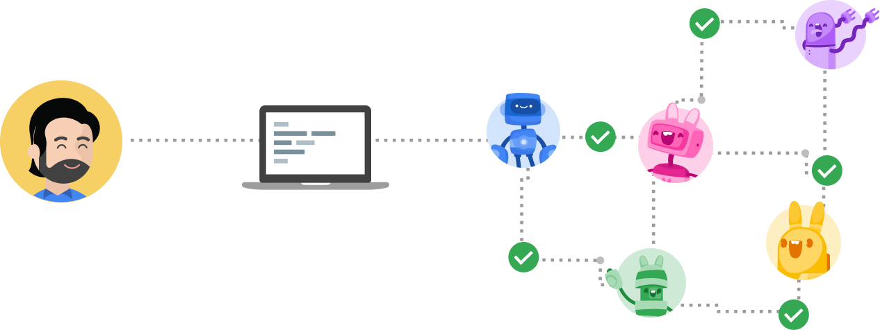
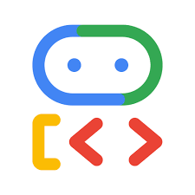
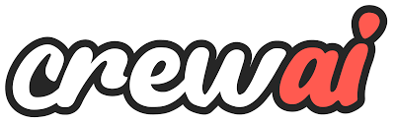

What is
Agent to Agent (A2A)
A2A protocol
A2A protocol
Definition:
The A2A protocol enables diverse AI agents (e.g., from ADK, CrewAI, LangGraph) to “talk the same language” (a common protocol) and follow specific processes to complete user tasks together.
Built on top of existing, popular standards including HTTP, SSE, JSON-RPC
How it works
How it works
Client Agent
Client Agent
End-User
End-User
Client
Client
Remote Agent Mesh
Remote Agent Mesh
Notes:
This slide is not just a question—it’s an invitation to reimagine what your enterprise could truly be.
For too long, we've focused on incremental gains, trying to make our employees slightly faster at their repetitive tasks. That model is outdated. The old way was constrained by siloed, app-dependent work. The new way is about limitless potential.
What if every one of your employees could harness everything that AI has to offer, working not just faster, but smarter and more creatively?
Imagine your workforce is suddenly multidimensional: They are freed from the friction of repetitive work, capable of doing more with less, and are empowered to focus their time and energy on strategic, high-value activities. They are not just completing tasks; they are becoming strategic innovators.
This shift ignites true team productivity. It unlocks the collective intelligence of your organization. It is the path to achieving More creativity, more impact, and more possibilities across your entire business.

Slide 24
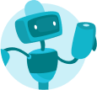
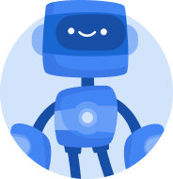

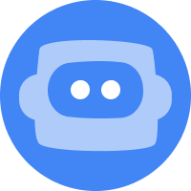
What is the difference between
Agent Tools and SubAgents
Specialize Agent 1
(e.g. ADK)
Specialize Agent 2
(e.g. LangGraph)
Client/Router
Agent
…
End-User
Client
Specialize Agent N
(e.g. CrewAI)
Servers
(Remote Agents)
The End-User can be a human directly interacting with an application or an automated service that needs to accomplish a specific task through the agent network.
The Client is a service, another AI agent, or an application that discover and interact with Remote Agents (Servers) to fulfill the End-User's needs.
The Server receives requests from Clients, executes tasks, and returns results or updates, all without needing to reveal its internal workings or proprietary logic (opaque "black box").
Notes:
Option 1 (Shorter talking points if you’re double clicking into each pillar and presenting slides 13, 14, 15)
So, what does that mean for your teams every day? We like to think of Gemini Enterprise as the new front door to AI in the workplace.
First, we help every individual go from tedious tasks to high-impact work. This is all about empowering your people with a ready-to-use AI taskforce so they can focus on what matters most.
Second, we enable anyone to build and share their own agents, all securely grounded in your organization's data. This is about democratizing innovation, allowing any employee to scale their unique knowledge across the entire business.
And finally, we ensure you can govern agents securely and scale with confidence. This provides the foundation of trust and control that makes enterprise-wide AI adoption possible.
These are our three core promises. Let’s take a closer look at how we deliver on each one, and how this comes to life for employees.
Option 2 (Expanded talking points if you’re only using this slide)
So, what does that mean for your teams every day? We like to think of Gemini Enterprise as the new front door to AI in the workplace.
[Go from tedious tasks to high-impact work] This starts with an intuitive chat interface, giving every employee direct access to our most advanced Gemini models. From there, they can call upon a ready-to-use AI taskforce — with specialized agents from Google and our partners for deep research, data insights, and coding — to automate complex workflows and free your teams to focus on their most important work.
[Turn team expertise into custom-built AI for everyone] Second, Gemini Enterprise is a platform for every employee, not just developers. Any user, from marketing to finance, can use powerful no-code tools to create their own AI agents. They can connect these agents to their specific business data and favorite productivity apps, and then publish them for the entire organization to use — turning their unique expertise into a scalable asset for the business.
[Govern agents securely and scale them with confidence] Finally, Gemini Enterprise is built for enterprise-grade control and compliance. Gemini Enterprise gives you a central place to visualize, secure, audit, and govern every AI agent being used — whether they were built with Gemini or even with other models. This gives your IT and security teams the full visibility and control they need.

Slide 25
Why is 2+2 with an LLM a critical mistake?
An LLM must parse text, reason about the intent (math), and generatively sequence a textual answer ("4")
To Sum Up
♻️⏱️
🔋💸
🤦‍♂️❓
High Latency & Wasted Resource
High Energy & Monetary Cost
Non-Deterministic & Unreliable
A simple Python function (2+2) executes in nanoseconds and spends much less computational resources.
Inference on large models consumes significant energy and it may costs real money.
The LLM predicts the next token. It doesn't calculate, It guesses the answer based on its training.
Notes:
Option 1 (Shorter talking points if you’re double clicking into each pillar and presenting slides 13, 14, 15)
So, what does that mean for your teams every day? We like to think of Gemini Enterprise as the new front door to AI in the workplace.
First, we help every individual go from tedious tasks to high-impact work. This is all about empowering your people with a ready-to-use AI taskforce so they can focus on what matters most.
Second, we enable anyone to build and share their own agents, all securely grounded in your organization's data. This is about democratizing innovation, allowing any employee to scale their unique knowledge across the entire business.
And finally, we ensure you can govern agents securely and scale with confidence. This provides the foundation of trust and control that makes enterprise-wide AI adoption possible.
These are our three core promises. Let’s take a closer look at how we deliver on each one, and how this comes to life for employees.
Option 2 (Expanded talking points if you’re only using this slide)
So, what does that mean for your teams every day? We like to think of Gemini Enterprise as the new front door to AI in the workplace.
[Go from tedious tasks to high-impact work] This starts with an intuitive chat interface, giving every employee direct access to our most advanced Gemini models. From there, they can call upon a ready-to-use AI taskforce — with specialized agents from Google and our partners for deep research, data insights, and coding — to automate complex workflows and free your teams to focus on their most important work.
[Turn team expertise into custom-built AI for everyone] Second, Gemini Enterprise is a platform for every employee, not just developers. Any user, from marketing to finance, can use powerful no-code tools to create their own AI agents. They can connect these agents to their specific business data and favorite productivity apps, and then publish them for the entire organization to use — turning their unique expertise into a scalable asset for the business.
[Govern agents securely and scale them with confidence] Finally, Gemini Enterprise is built for enterprise-grade control and compliance. Gemini Enterprise gives you a central place to visualize, secure, audit, and govern every AI agent being used — whether they were built with Gemini or even with other models. This gives your IT and security teams the full visibility and control they need.

Slide 26
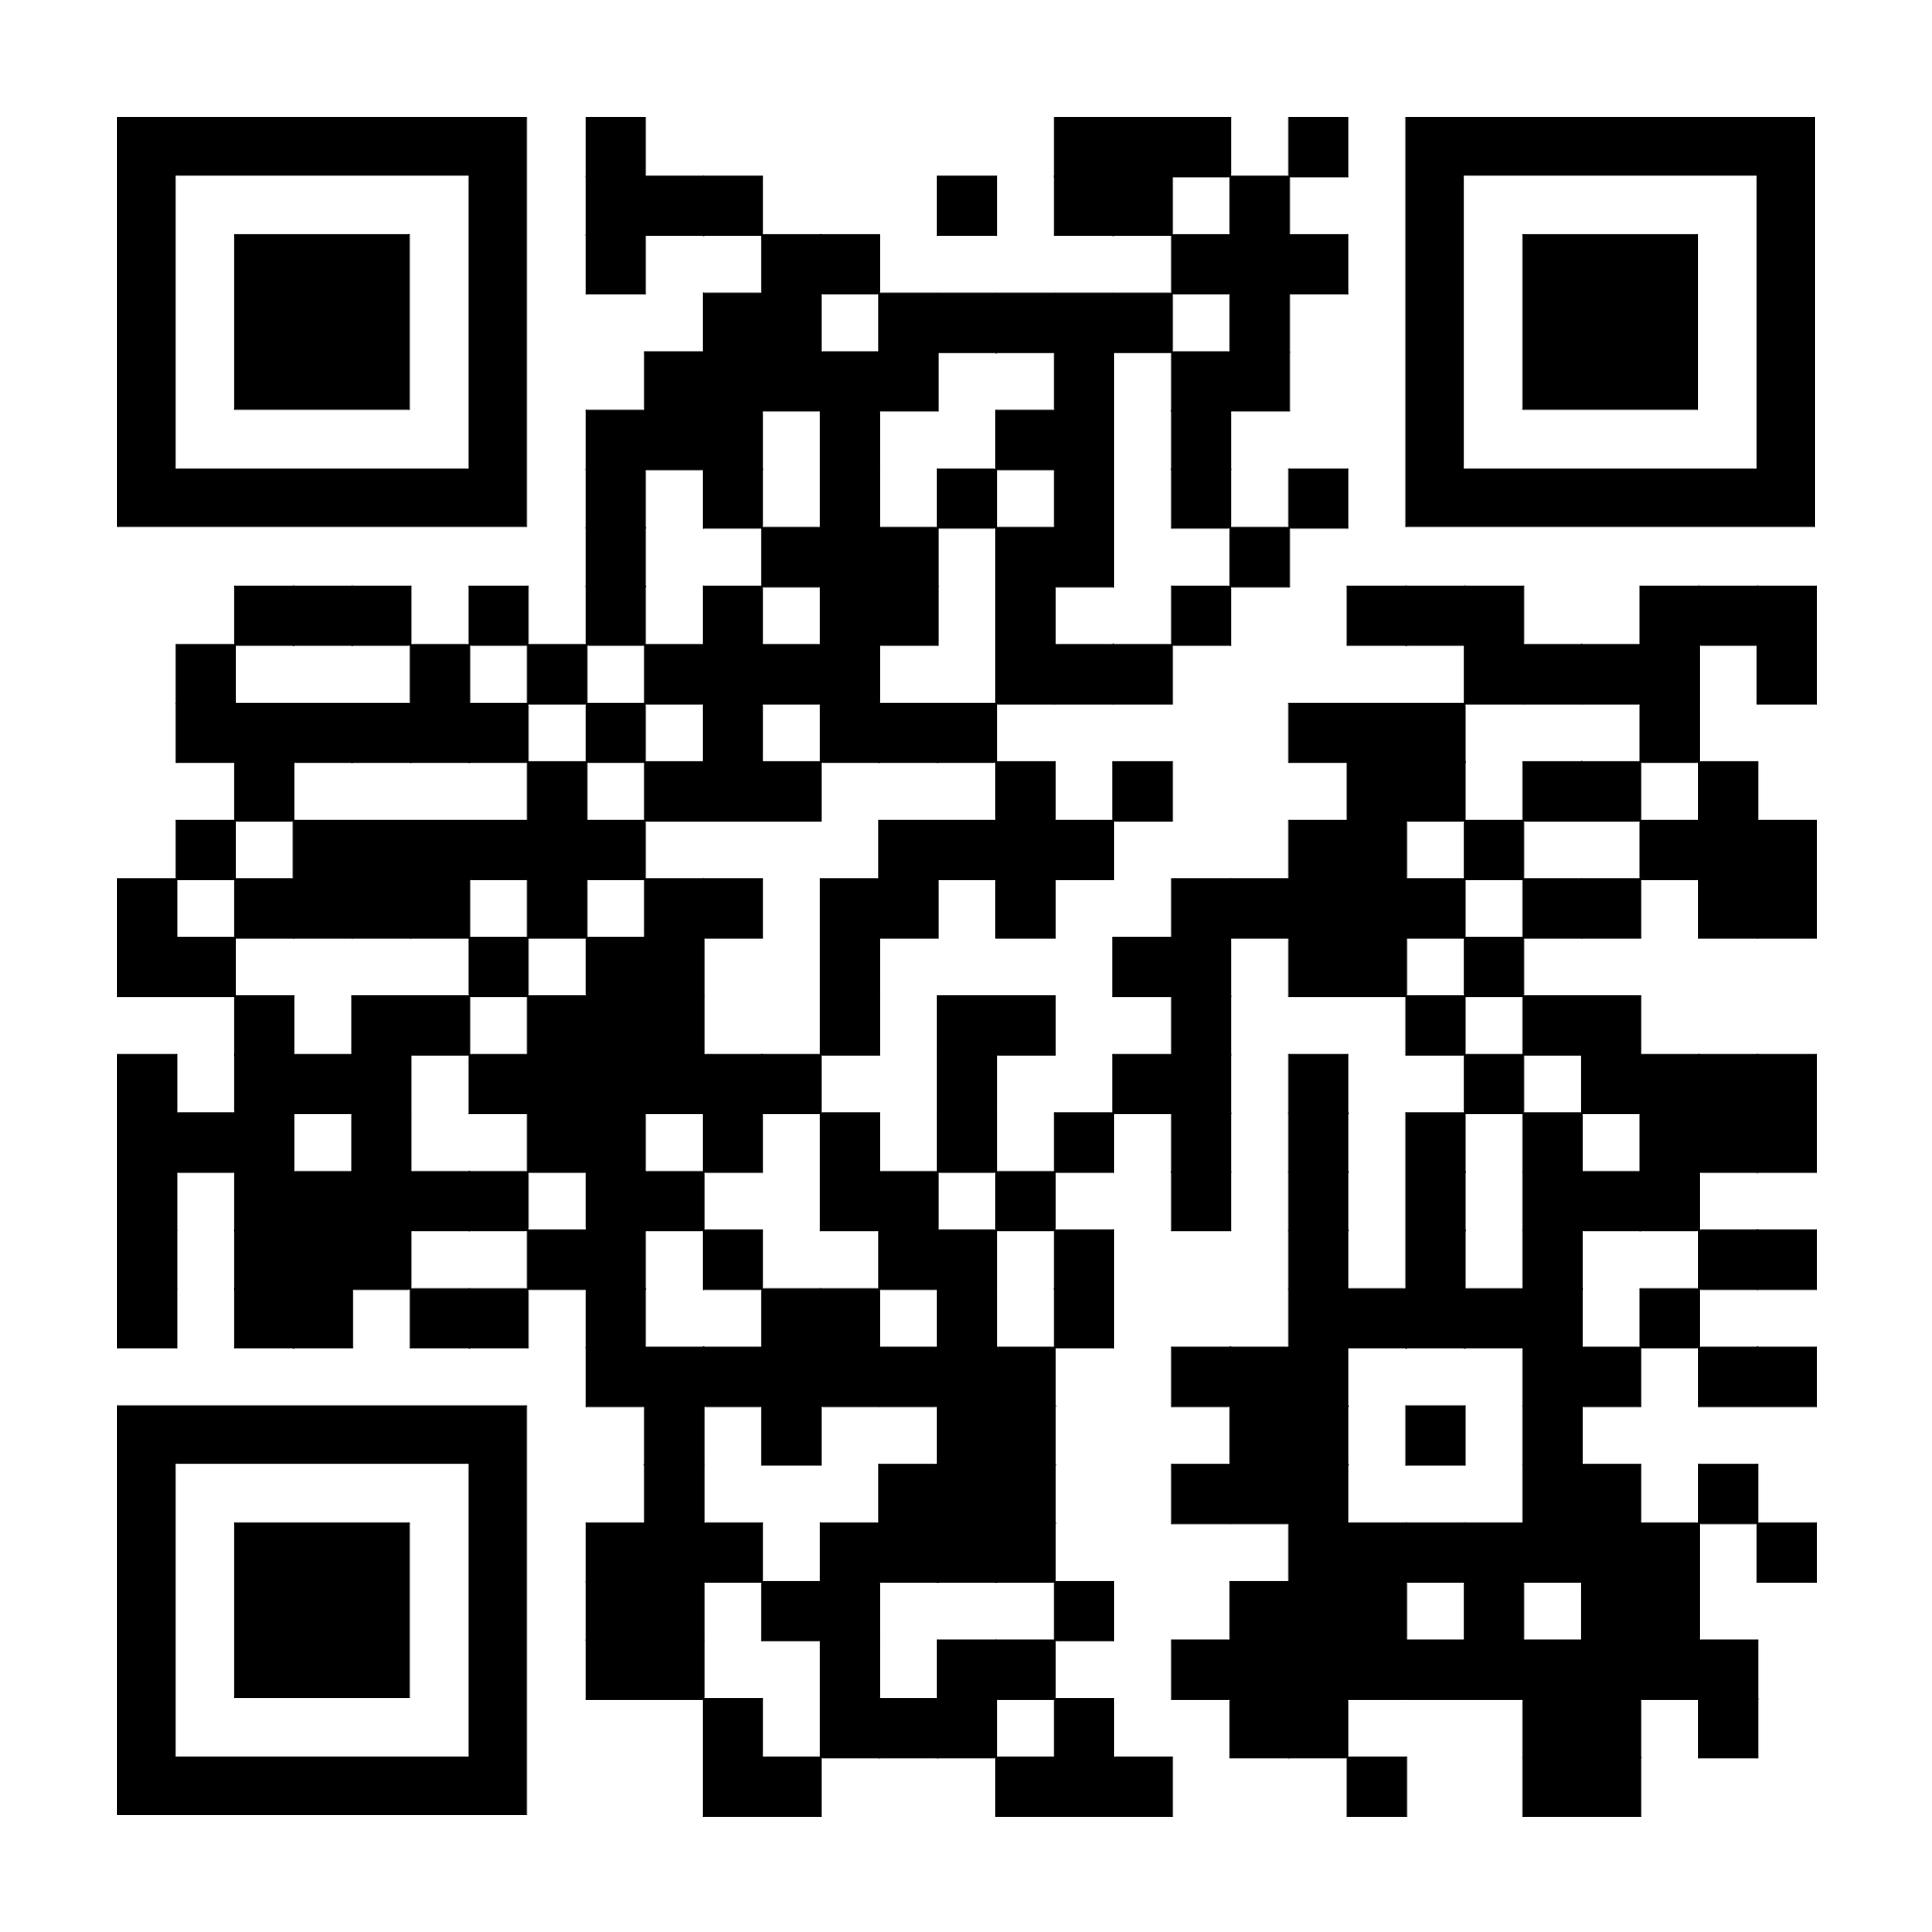
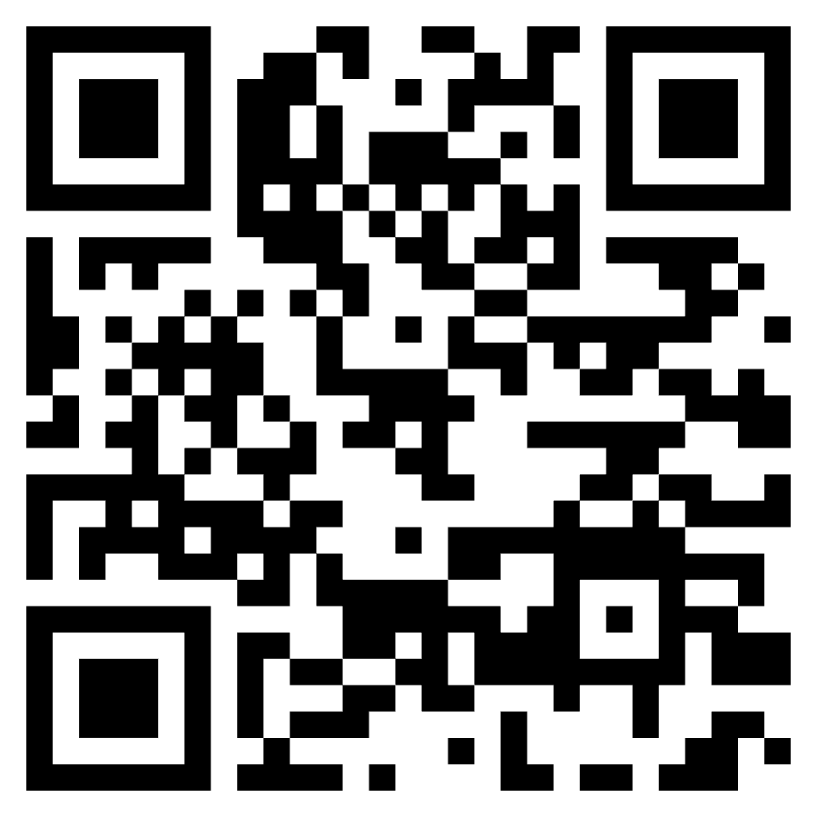
Some more questions…
Q&A
Slides here
If you want to learn more about…
ADK docs, videos, samples, hackathon
Agent Starter Pack
Codelabs: Google's Agent Stack in Action:ADK, A2A, MCP on Google Cloud,
& A2A Agentic Trading end-to-end example
Blogs: IO announcement, MCP+ADK
Ollama: download, docs
Notes:
This slide is not just a question—it’s an invitation to reimagine what your enterprise could truly be.
For too long, we've focused on incremental gains, trying to make our employees slightly faster at their repetitive tasks. That model is outdated. The old way was constrained by siloed, app-dependent work. The new way is about limitless potential.
What if every one of your employees could harness everything that AI has to offer, working not just faster, but smarter and more creatively?
Imagine your workforce is suddenly multidimensional: They are freed from the friction of repetitive work, capable of doing more with less, and are empowered to focus their time and energy on strategic, high-value activities. They are not just completing tasks; they are becoming strategic innovators.
This shift ignites true team productivity. It unlocks the collective intelligence of your organization. It is the path to achieving More creativity, more impact, and more possibilities across your entire business.

Slide 27
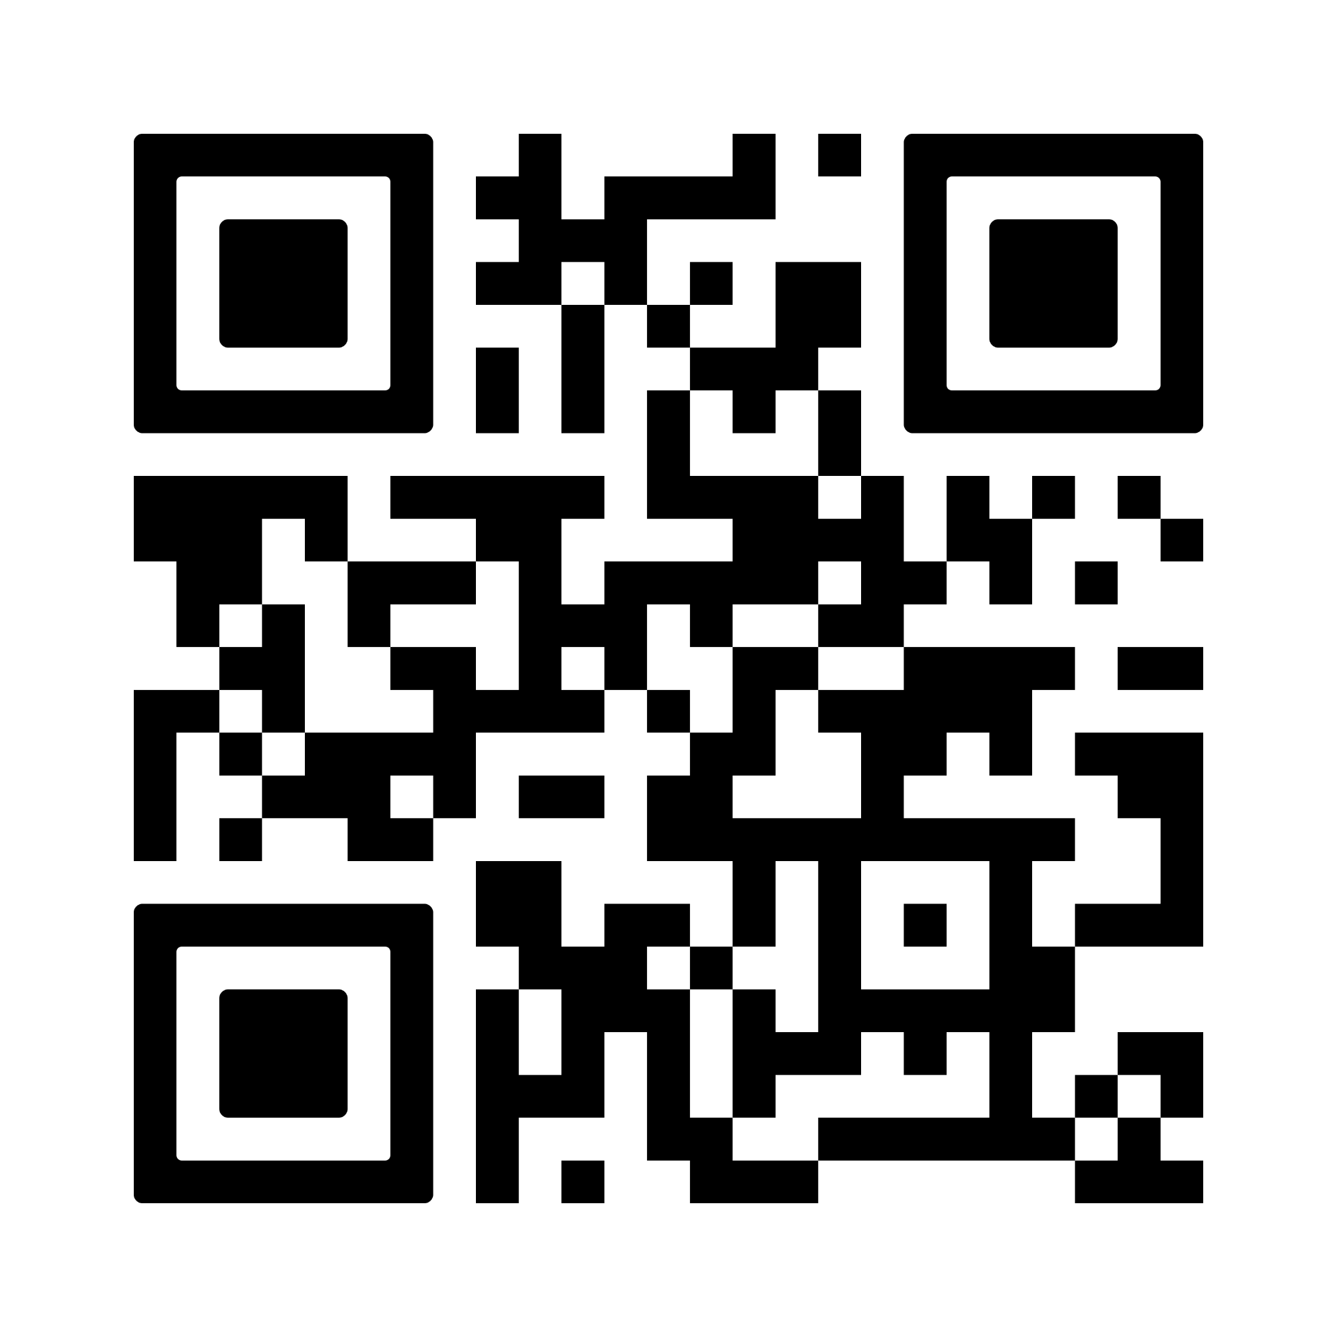

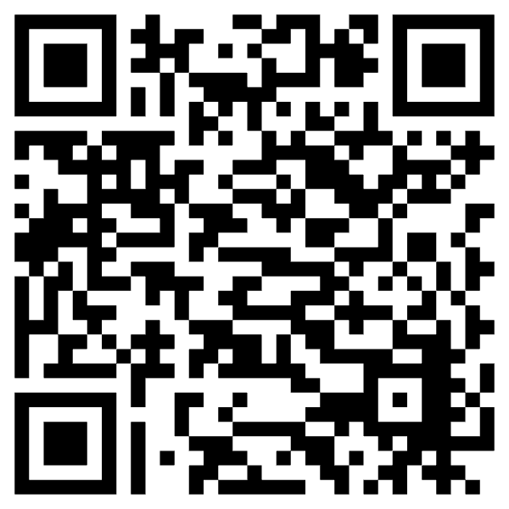
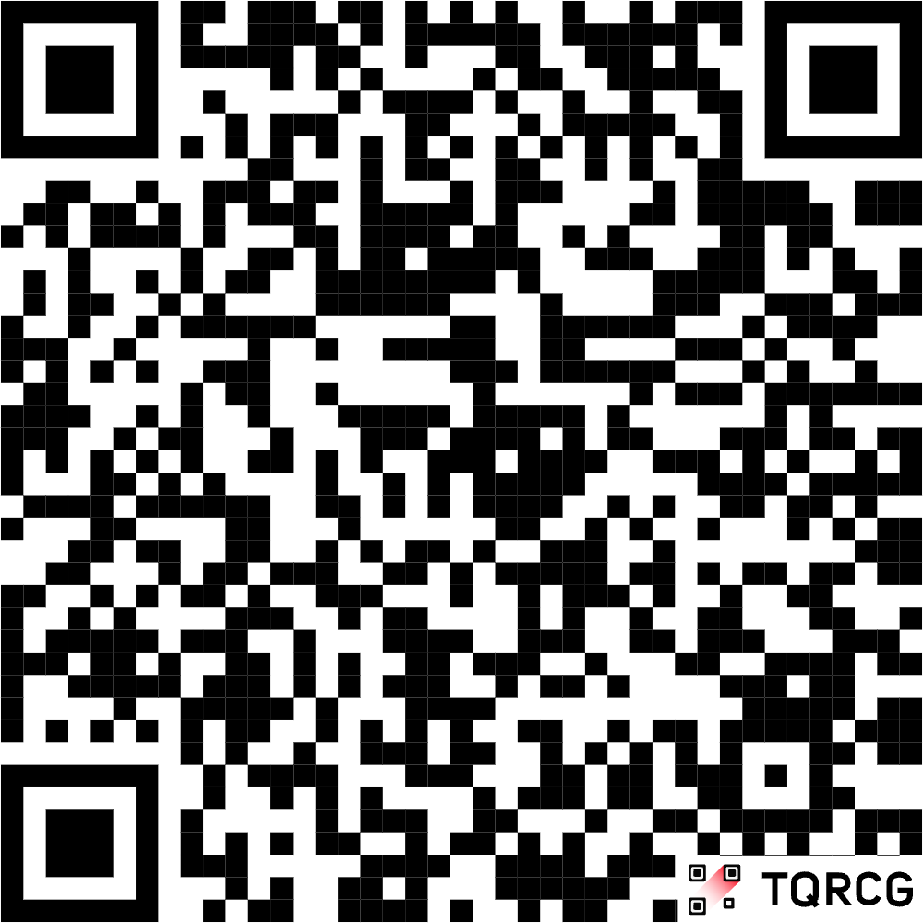
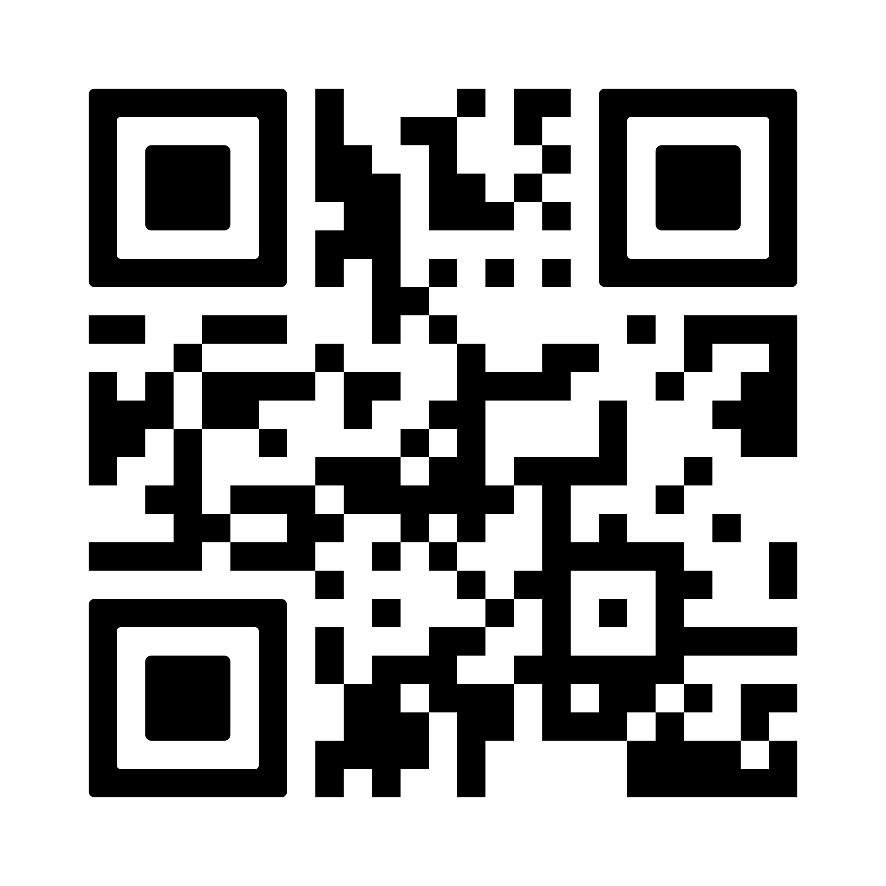

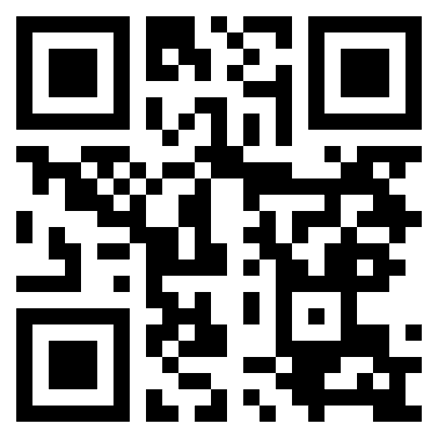
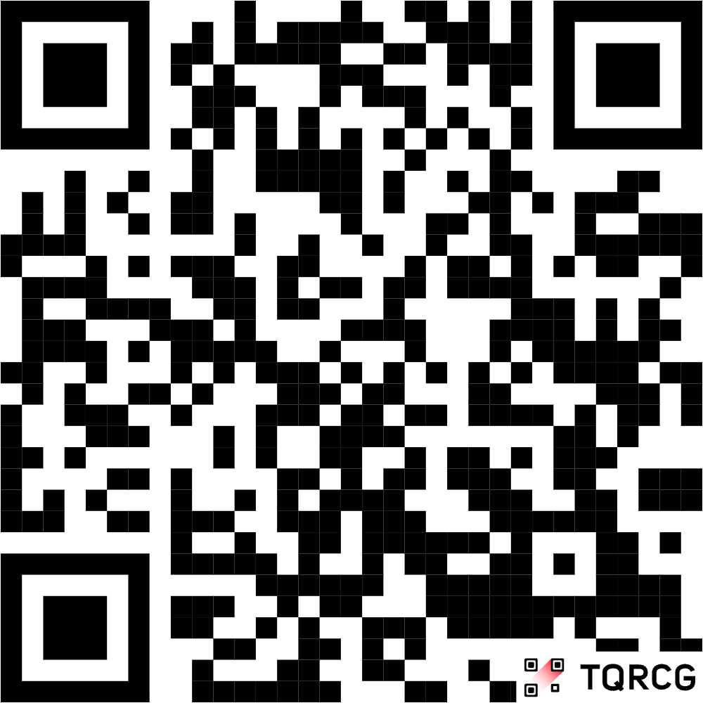
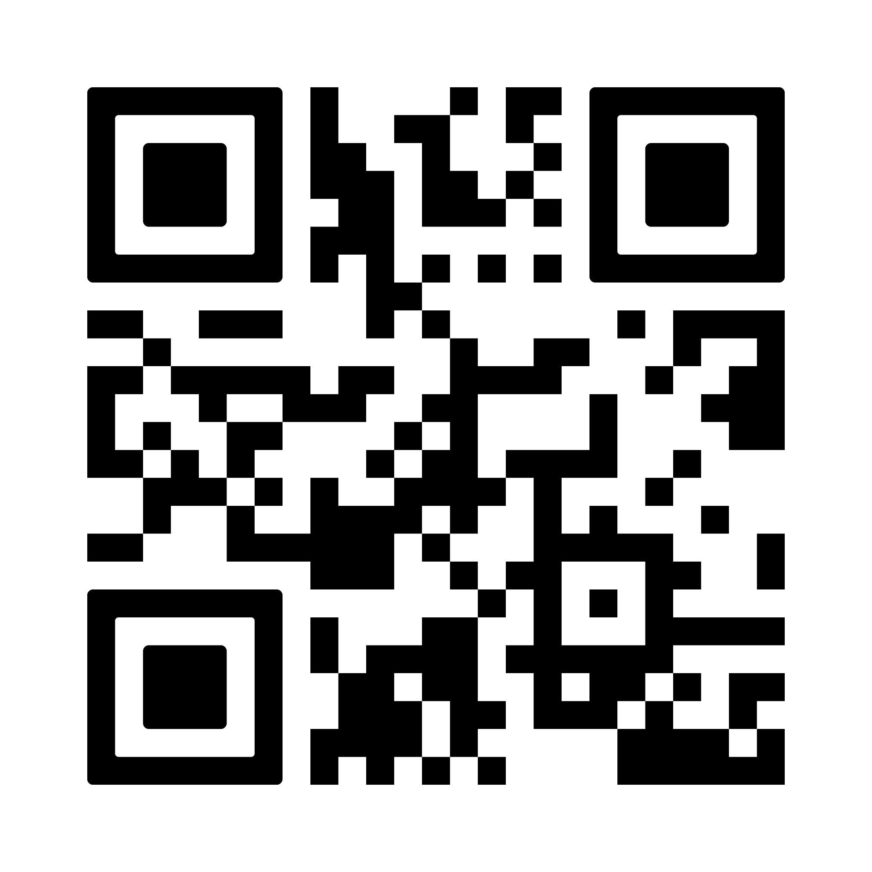
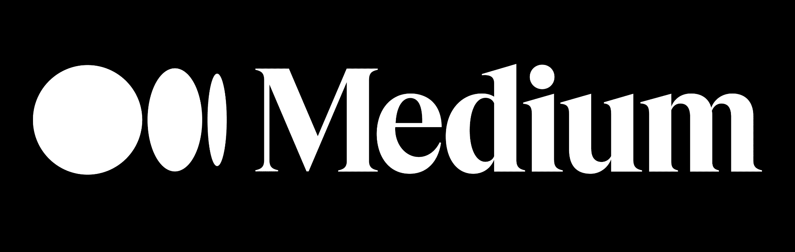
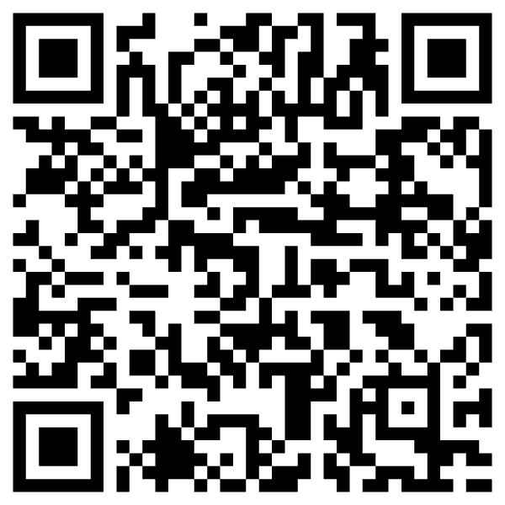
This is the end…
Thank You
What to stay in contact…
Notes:
This slide is not just a question—it’s an invitation to reimagine what your enterprise could truly be.
For too long, we've focused on incremental gains, trying to make our employees slightly faster at their repetitive tasks. That model is outdated. The old way was constrained by siloed, app-dependent work. The new way is about limitless potential.
What if every one of your employees could harness everything that AI has to offer, working not just faster, but smarter and more creatively?
Imagine your workforce is suddenly multidimensional: They are freed from the friction of repetitive work, capable of doing more with less, and are empowered to focus their time and energy on strategic, high-value activities. They are not just completing tasks; they are becoming strategic innovators.
This shift ignites true team productivity. It unlocks the collective intelligence of your organization. It is the path to achieving More creativity, more impact, and more possibilities across your entire business.

